Slide 2
Solid Waste Management Plan Amendment No. 4
Current System & Plan Amendment Process
Presented on April 25, 2018 by Taussef Waraich, Manager, CVRD Recycling & Waste Management Division

Slide 3
What is a Solid Waste Management Plan?
Collection
Processing and composting
Waste Reduction
Education
Financing
Disposal
Provides a 20 to 30 year vision for managing waste
Clear actions for 10 years
Covers municipal solid waste, including garbage, recycling, organics and food waste, and construction/demolition waste
Does not include agricultural, forestry, liquid or hazardous waste
Sets targets for waste reduction

Slide 4
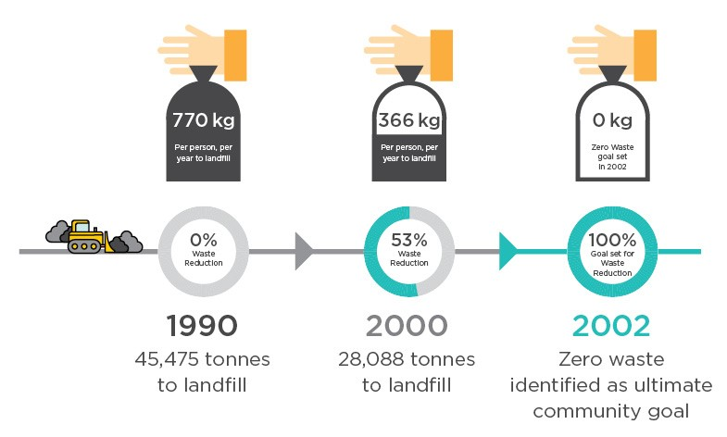
Zero Waste
Why are we updating the Plan?
Current plan is more than 10 years old (last updated in 2006)
Need to make sure plan is current, and reflects region’s goals & objectives for waste management
Plans set out targets for waste reduction, and should identify gaps and opportunities for improvement

Slide 5
Pollution Prevention (5R) Hierarchy)
Solutions should be prioritized according to the 5R hierarchy of Reduce, Reuse, Recycle, and Recover before disposing of Residuals

Slide 6
How Much Waste Do We Produce?
Our region produced 77,000 tonnes of material in 2017, more than 60% was recycled
Community members throw out 358 kg of waste per person every year

Slide 7
What’s in Our Garbage?
Lots of what is sent to the landfill is recyclable
24% compostable organics
17% recyclable plastics
13% non compostable organics (e.g. wood waste)
11% recyclable paper

Slide 8
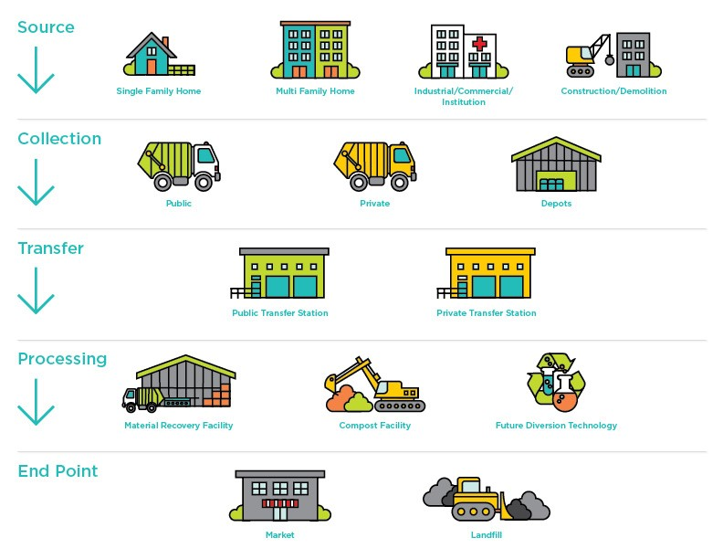
What Happens to Our Garbage?
Any material not recovered is sent to the landfill
There is no landfill in the CVRD, waste is shipped to Washington State, USA
Shipping waste is expensive
It’s important to reduce waste to save $ and protect local recycling jobs

Slide 9
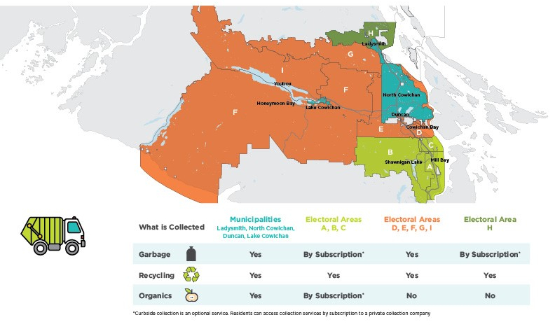
Curbside Collection Services
Service levels are inconsistent
Not all residents can access garbage or organics (food waste) collection at home

Slide 10
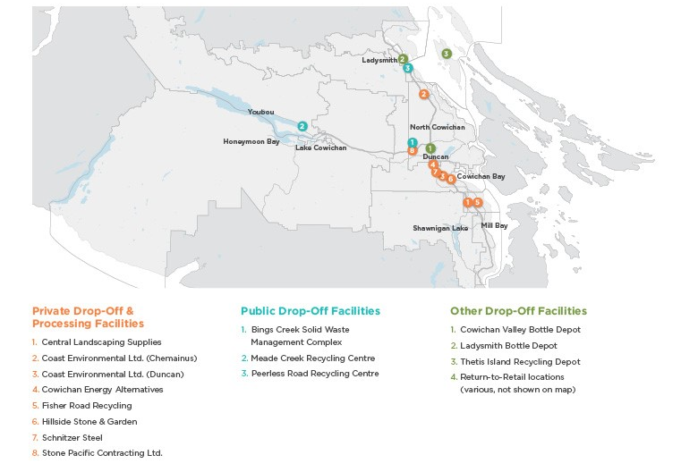
Drop-Off Depots & Processors
Lots of options for recycling
Strong local recycling industry = jobs in the local economy
Public depots near Duncan, Lake Cowichan and Ladysmith
No public depot in the south end but there are private depots
Four local composting facilities

Slide 11
How Do We Pay for Waste Management?
CVRD provides regional waste management:
Three public depots
Waste management planning
Education
Funded through taxation and tipping fees
All residents contribute

Slide 12
How Do We Pay for Curbside Collection?
Curbside collection programs are managed separately
Municipalities have their own programs
CVRD services Electoral Areas
Recycling in all 9 areas
Garbage in 5 areas
No taxes, 100% funded by user fees & Recycle BC

Slide 13
Planning for the Future
We need to do better to meet and beat Provincial targets
How can we get there?
How do we challenge ourselves to do better?

Slide 14
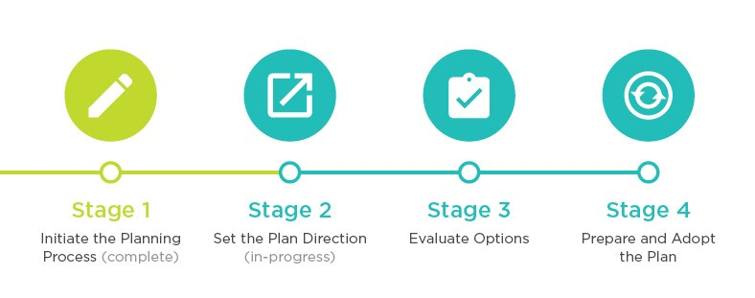
Where do we go from here?
Next Steps:
Public survey (this week)
Open Houses (July – August)

Slide 15
Thank You
Join the conversation online:
PlaceSpeak.com/SWMP
cvrd.bc.ca/SWMP

